Slide 1






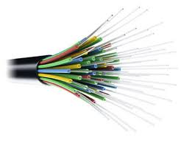
T-TEG Platform for Bharatnet OFC infrastructure
TransTEG Lifecycle Pvt Ltd
Anuj Kumat, CTO & Founder
+919910376192
anuj@t-teg.com
https://t-teg.com
Enabling the Business Lifecycle of Telecom Optical Fiber Cable Networks
1

Slide 2

Scope – Proposed transformation roadmap
Executive governance
Synergy & Settlement - Optimum internal and external resource management
Vendor management (External / Internal) – SCM support – techno commercial integrations
AI/ML driven Data Lake & Automation driven C-NOC – Business & Tech integrations
Task management - Tech enabled Work Orders / Trouble Tickets – creation to closure
BSNL - Billing and commercial management
Other customers (Airtel / Jio / Tata / Voda etc.
Planning
Deployment
Acceptance
Operations
OFFERED
BSNL
SCOPE
  GIS planning
  Survey
  BoQ
  T&D
  Blowing
  Splicing
  eMB / ABD
  End to end testing / OTDR
  IE interactions
  MSA automation
  Predictive maintenance
  Incident management
Accurate Location
Mobile App based data capture
Traceability based reporting
Payment terms integrations
Data lake readiness
Sales portals & MSA integrations

Slide 3
Project Delieverables Summary
Scope
Project Execution / Milestones
SLAs and Penalties
Construction of new fiber / upgradation / RESTORATION of existing BharatNet Phase I/II networks (linear to ring/IP-MPLS).
Construction Phase
  Delay in meeting milestones: 0.5% of incomplete GP value/week up to 10 weeks, 0.7% thereafter (max penalty: 12% of package cost).
Asset Handover/takeover from BSNL – block wise
O&M) of existing /new networks with milestones and KPI/SLA
Completion – 36 months progressive ring/GP commissioning.
  Penalties
    Uptime (Block-wise, Monthly)
    GP OFC Cut counts
    O&M at S-NOC: KPI below target
    O&M at GP (Ring): Severe Penalties
      Mean Time to Repair (MTTR): Penalties for > 8 hours
O&M Phase
Establishment / management of S-NOC for Monitoring.
OFC Laying: Underground (HDD) – armoured OFC, aerial with BSNL / IE approval
Quality Assurance & Standards
  Latest TEC GRs and Section IV-C/BOM
  Acceptance & Field Testing QA, IE & PIA roles for material, PAT, FAT, sample route/site checks
  Videography/Photographic Proof: Geo-tagged, timestamped for ducting, blowing, splicing, OFC laying
Enable Retail, Enterprise, and Wholesale broadband services as per MSA
IP-MPLS ring completion as per TEC/ BSNL specifications.
Use of Software Tools can play a major role

Slide 4
T-TEG platform – contribution areas
Project governance & PMO
Key Skills enabled by T-TEG
Handover / Takeover
  Duct level GIS planning
  Survey and Patrolling
  Mobile App based Paperless data capture to Cloud / Server
  Field force management – task engine
  IE interactions automation for
    Plan – Do – Check – Approve
    Live view of work with zero manual intervention
  Data Lake for C-NOC usage
    Enables RCA / Predictive Operations etc.
Augmentation plan - Ring redundancy / New GPs
Deployment
Acceptance
Operations Phase

Slide 5
NOC / Automation areas in BSNL project
Customer experience / MSA
OSS / BSS
IP planning / Provisioning
Active electronics
Passive infrastructure
Fiber - logical inventory
OFC – Outside Plant
Duct system (or Aerial)
ROW / Real Estate
OFC Cable - laying, joint locations, Loop sizes, Splitters etc.
Accurate location & Depth - Manholes / Waypoints / Poles
ROW management
Fiber usage, termination, splicing
Racks / Power / access
IP / MPLS / PON etc.
This part contains C-NOC, S-NOC, GIS – teams working above the Fiber OSP layer. T-TEG can give integration inputs or query based outputs e.g. to a RCA Engine
Potential areas
  Introduce AI for RCA, Fiber Fault location, predictive Operations
  Global rollouts
Existing from other vendors
T-TEG platform for deployment & Lifecycle operations
Current Focus – 80-90% ready

Slide 6
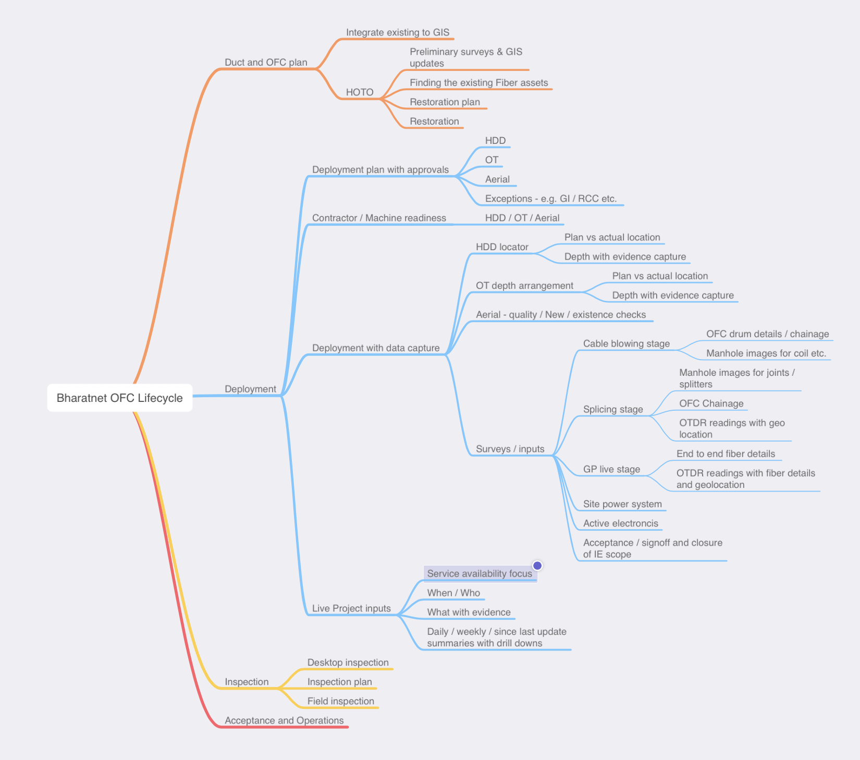
The Challenging end goal
Successful completion of Bharatnet Phase 3 needs complete control, paperless documentation & deep accountability coordination

Slide 7
Bharatnet phases for supporting Service KPI – REQUIRES FULL CONTROL
Network Planning - Precise planning & accurate Deployment
  Route / Inventory / BoQ
  First Time Right – coordinated deployment
  Planned vs Actual tracking
  Commercial interactions – budget vs actual
Deployment stage - IoT-Based Asset data capture
  Intervention free data capture in deployment
  Accurate GPS <20 cm accuracy
  Depth profile generators
  Image and Video analytics
  Evidence capture for data lake
  Inspection / Bill clearance
Tech data Integrations (other than EMS for FCAPS / voltage / current etc.)
  OTDR / Splicing machine / GPR
  Cable fault locators
  Power system @ Block / GP
  Workflows for accountability (PDCA captures) / rating
Automation based governance
  KPI measurements / publish with drill downs
  TAT / SLA measurements for TT / WO on mobile app
  Contextual support with RCA
  Fiber fault XYZ location predictions
  Live inventory picture
  RCA automation integrated to task engine
Service request & CRM portal
  Live view of network with bandwidth / DF availability
  Automated SR process with faster TAT
  Transparent project status with integrated inspection, handover and takeover processes
Eliminate manual intervention & data entry, Align everything to Billing

Slide 8
Typical Bharatnet Challenges – Digital Bharatnet Tender compliances
Rollout - Process streamlining / delays
Billing - Assembly process
M1
M2
M3
M4
--
--
M11
M12
--
Active Electronics
Block/GP
Passive Equipment
Smart Rack
power systems
Outside plant
Existing ABD / HOTO
New ABD / inventory
S-NOC
End to end testing
OTDR
Functional AT
Live Scope accounting
Blocks
GP
Existing km
New km
Plan
Existing ABD
Additional / Restoration
IE approval / Released for execution
T&D
Live tracking and First Time right
Manhole / Blowing
Typical <20 cm non-compliance
Zig zag / Missing data
No Roadometer match
Depth challenges
BSNL monitoring – check before publish
Workflows with IE
Splicing
OSP testing / OTDR
Bill - unique data set
Block / GP subset - Stage 1
Block / GP subset - Stage 2
Block / GP completion
Live consolidation of data and Ensure First Time Right for future data
ABD subset
FAT
MB subset
ABD subset
FAT
MB subset

Slide 9
How to handle the challenging scope – T-TEG as Single source of validated truth
Key T-TEG technologies
  Intervention free data from field Mobile app integrated to T-TEG Web interface and GIS
  Task engine (uses location / log in / log off / work space concept)
  BSNL integrated Web interface with data and evidence integrated
  Integrations
    Own IOT
      Independent <20 cm accurate Geotron GPS , Depthking - Depth profile generator for OT
    Locators for HDD - Depthvision & DCI, Depthvision Cable locator , OTDR capture
During Planning / Survey / HOTO (start accumulating data)
During deployment and supporting surveys (create paperless validated documentation)
Operations stage – data lake for NOC integrated to TT / WO, RCA, Inventory applications
  Integrate incoming GIS data
  Duct level Plan on GIS
  Use task T-TEG engine
  Block / GP surveys
  Known route / manholes
  Found route / manholes
  Power system details
  OTDR traces
  Administrative details
  Accurate Geolocation with Date / Time
  Point Evidence with calibration trails
  Videos and images with Geo tagging as per tender
    HDD / OT / Cable blowing / pulling stage / Joint locations / splicing details / Location references with images
  Auto MB / Material reco / Inventory
  Inspection stage - Authorised data sharing with IE / BSNL as tasks / Generate signoff formats
  Data lake - field asset data, change history, accountability / traceability
  Use patrolling app - live data available on site always
  Network changes captured with same engine

Slide 10
T-TEG Billing related – Customise, Test & get IE / BSNL approval
Billing Module – Control layer
Online Billing – Legends to depict route / end point status – plan / in WIP / complete / Billed / S-NOC view
UI for required viewing “snapshot” with legend for WIP stage / Ready for Bill / Billed
Online MB
Online MB – sums up entry / exit AXY and calculated length with drill down to shot level / Dynamic BoM
UI for required viewing “snapshot” with status updates (T&D stage / Blowing stage / Splicing / testing)
ABD
Quality control for ABD – Online with Daily closure – manual check route, automations (No. of TP / AXY / Pit locations – count of images and videos. Depth monitoring with evidence check
Live ABD – summed up to Shot level (Daily output level for OT) & further to Planning linked route ID
Task management
Straight / Branch joint locations as per Task
Splice joint image capture (mapped to accurate XY
Splicing machine screen capture for joints / tabular data if any
Mobile App
Manhole / Handhole construction verification as per Task
Cable pulling / blowing, OFC Drum, chainage, Duct end caps / sealings
Map to Accurate XY
Geotron (Base service)
Locator (s) / Depthking for OT / Measuring Staff / Cable locator (Validation)
Machine location, Tracker details, Duct drum with location
Accurate XY, Depth for Pits / Waypoints, Duct couplers, end caps
Pilot entry Depth capture / 3 point Reference for pit / Reference and offset for route every 50 m (10 m for OT)

Slide 11
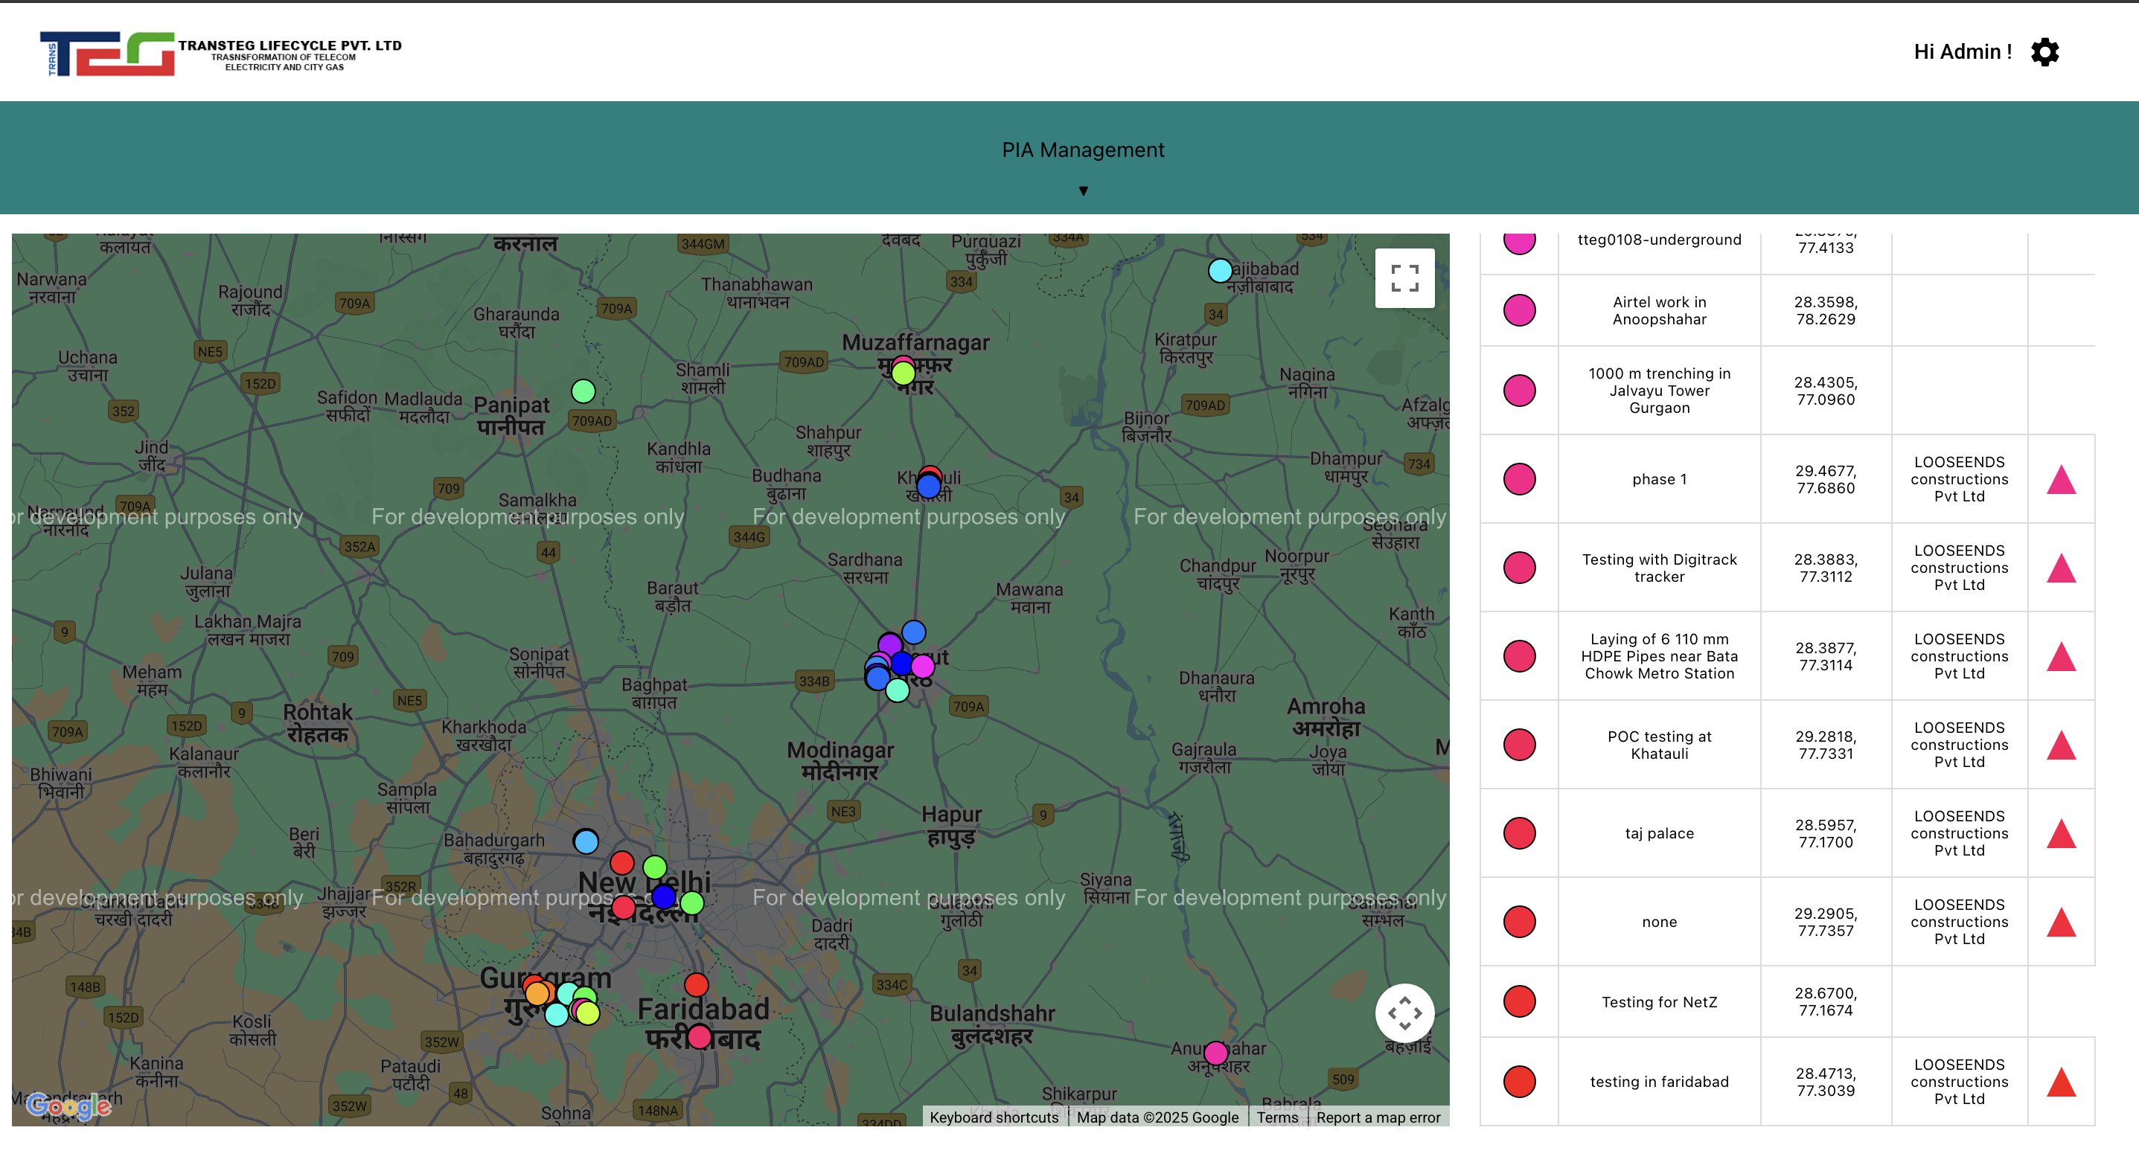
The PIA and IE Cockpit – Overview, drilldowns, summaries & data sharing
Contractor overview – machines / manpower / location / progress
Drill downs on Project summaries
Workflow based data sharing - PDCA
Intervention free Asset details capture
GPS / Depth profile integration – adding Cable locator / GPR
View as it happens or later for off site
Integrated DPR / material reco

Slide 12
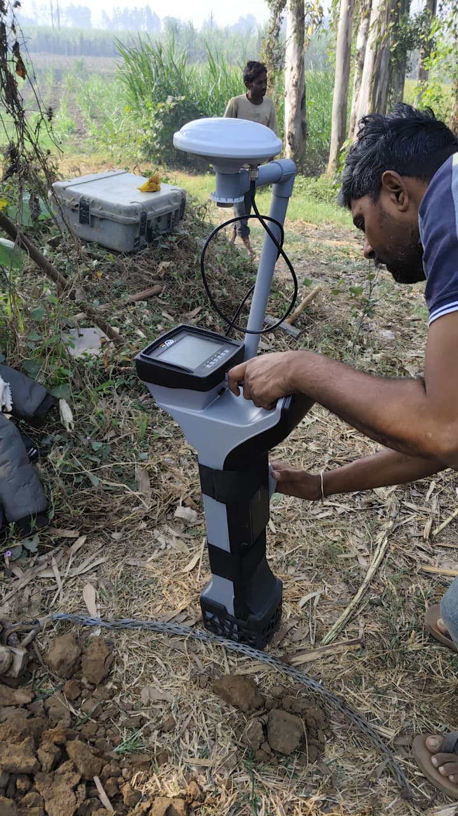
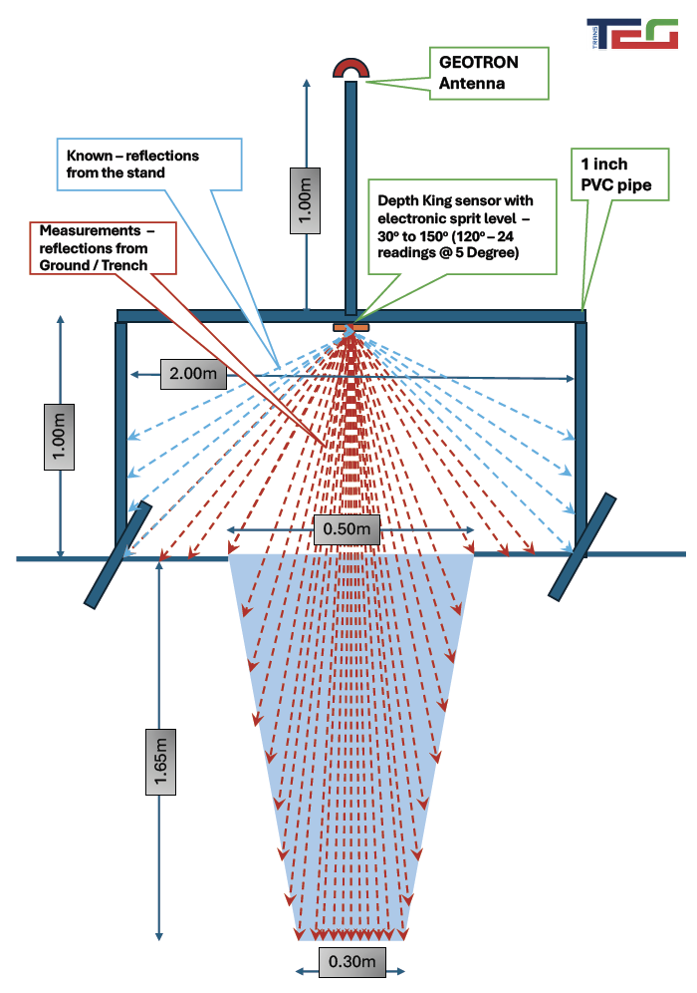
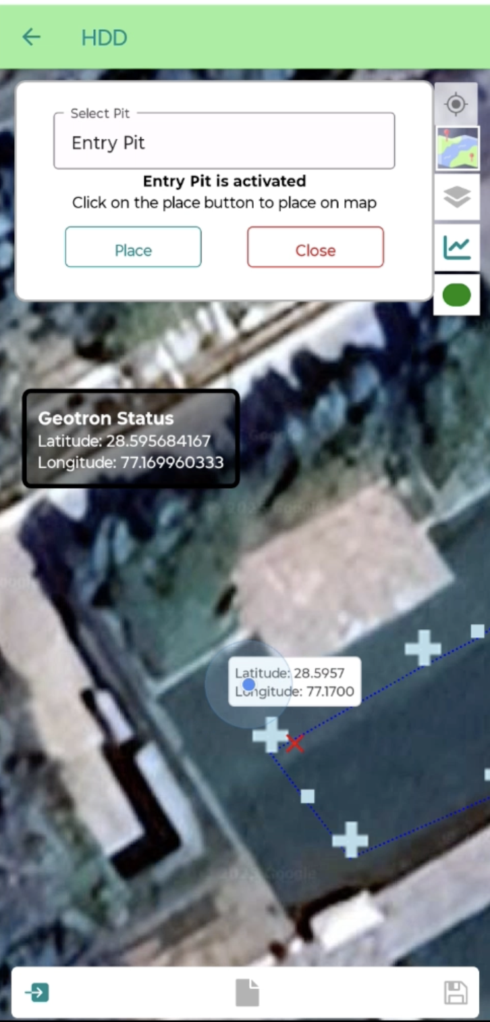
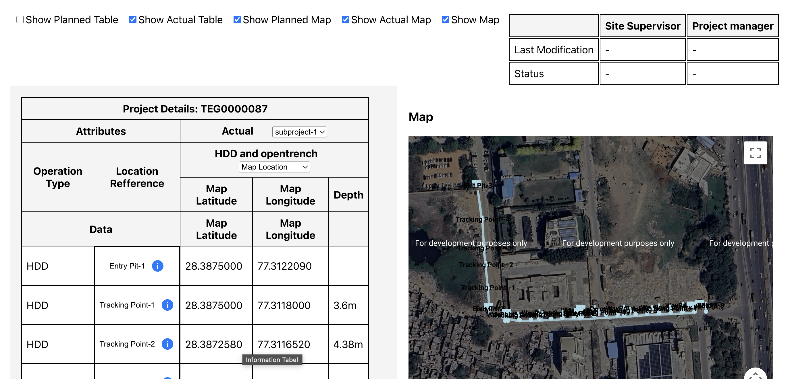
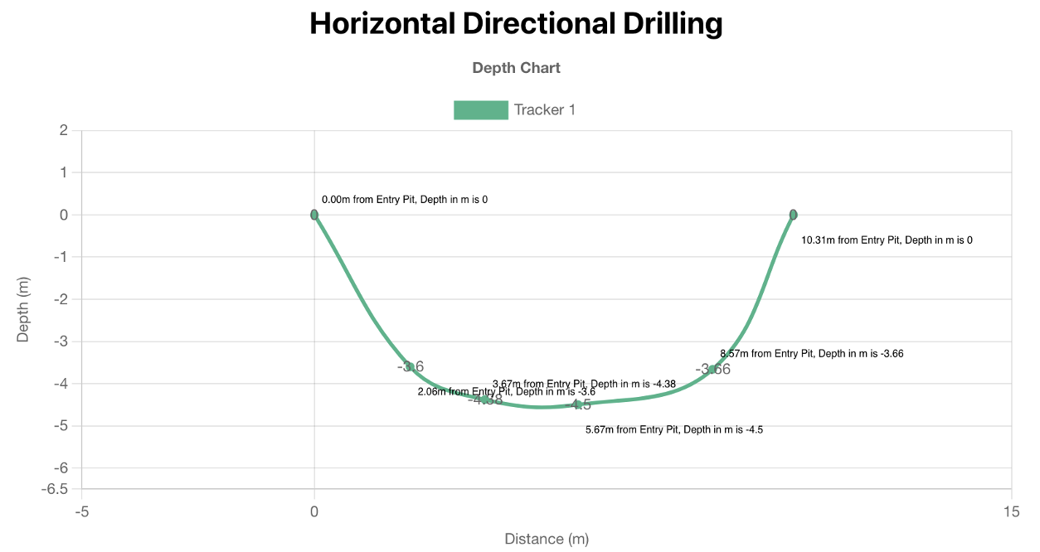
T-TEG Platform for HDD & Aerial OFC Lifecycle – Includes IE VALIDATION STREAM
Paperless Documentation
<20 cm GPS accuracy - autonomous
“App Button” Manual intervention free “location & Depth Capture
Integrated Mobile App
Cloud based, Live view
Offline inspection
As build drawings / MB / Billing
Project dashboards
Task control / management
Tracker / Ducting / Splicing automation capture
Full Bharatnet compliance
Integrated Web App
IOT devices for <20 cm GPS, Depth profile integrated to Mobile App

Slide 13
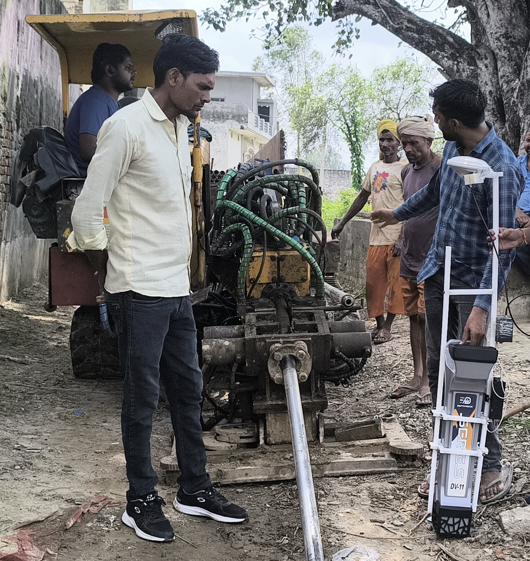
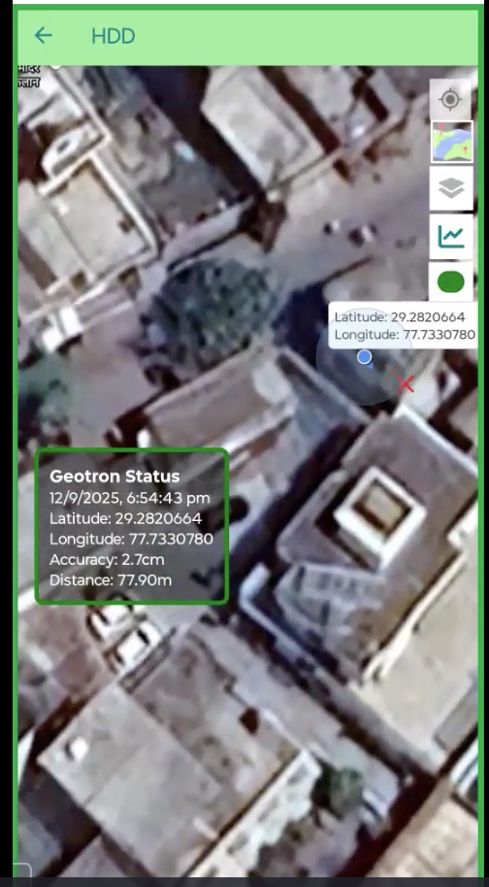
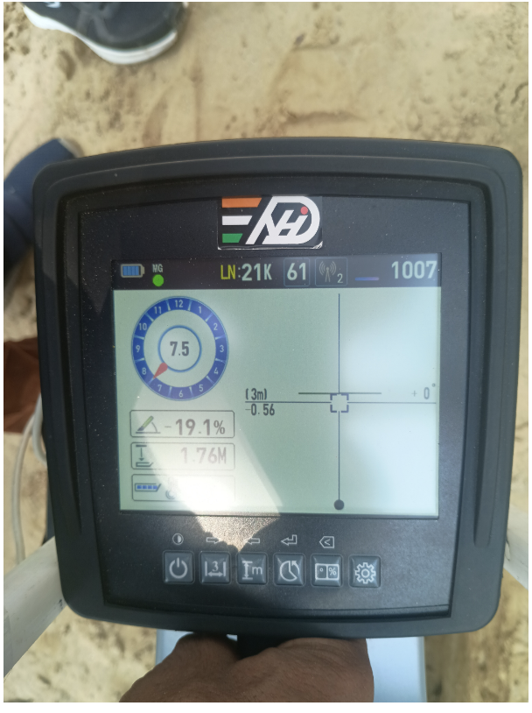
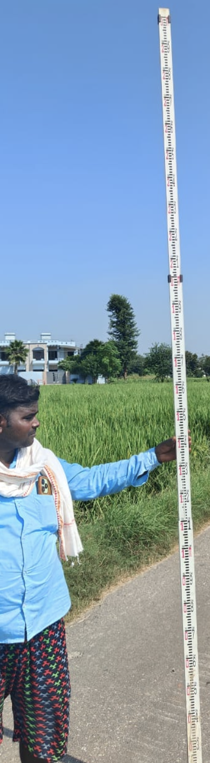
Ensuring Traceability in FIELD DATA collection
Field Data Collection steps
Live capture of field data – No additional manpower
Plan available – Route / Manholes / Duct / OFC – high level “Mapped BoQ”
Automatic Depth profile chart saves effort
Fully autonomous RTK option (Without CORS)
Traceability till Field resource level – Circle / District / Block / Route / GP being done by Contractor
Ready integration to Data lake for NOC
Work the plan capturing as builds live – e.g. HDD (Similar automation available for Open Trench)
Capture Calibration certificate of Locator
Use for Handover Takeover surveys
HDD Locator/ Open Trench work
Mobile App with integrated IOT <20 cm accuracy capturing depth evidence & sending directly to office
Field Calibration of Locator to ensure that correct depth is reported – Say till 5m
Adequate training to Tracker to capture data exactly when the Pilot is at 90 Degrees from Locator Receiver
Collection of references / offsets / evidence for cross check Online or on field in subsequent stages
P D C A process for Approvals
Automated dashboards for progress monitoring, Plan vs Actual, Escalations
Locator with Transteg IOT
Mobile App
Depth evidence capture

Slide 14
Controlling PIA – IE – BSNL interactions
Formal Documentation & Reporting
Design, Survey, and Planning Stage:
Material and Site Inspection:
Testing and Acceptance
  Project communications- design validation, test reports, quality compliance, milestones
  PIA submits progress reports, measurement books evidence including geo-tagged photos/video to BSNL and IE for Inspection, AT, punch lists, defect notes and certifications for PIA / BSNL
  PIA submits survey reports, network design, BoQ with supporting data
  IE reviews, provides comments/approvals with necessary modifications as a gate for BSNL to grant final site/block/ring approval
  PIA notifies IE of readiness for periodic or milestone site inspections, including material inspection, installation, or test events
  IE schedules inspections / documents findings reporting deviations or non-conformities are formally reported
  PIA raises requests to IE (in writing/e-mail and through any prescribed workflow tool) for PAT/FAT (TAT / SLA required)
  IE tests & issues written acceptance or rectification instructions
  Any punch-list items to be rectified & resubmitted for validation
Routine and Ad Hoc Audits
Exception Handling & Approvals
SLA Management and Penalty Assessment
Exit/Handover Phase
  IE conducts six-monthly audits/inspections of O&M
  IE provides justification, recommends to BSNL process is tracked and archived.
  Alternate technologies, less-than-standard OFC laying / deviations
  PIA submits detailed justifications / evidence to IE for technical assessment
  PIA regularly sends performance logs
  IE reviews, audits, and validates SLA performance data and for defaults, communicates penalty recommendations to BSNL and the PIA
  Detailed asset lists, status reports & handover/takeover memos prepared by PIA, certified by IE, and signed off by all parties as part of a structured process

Slide 15
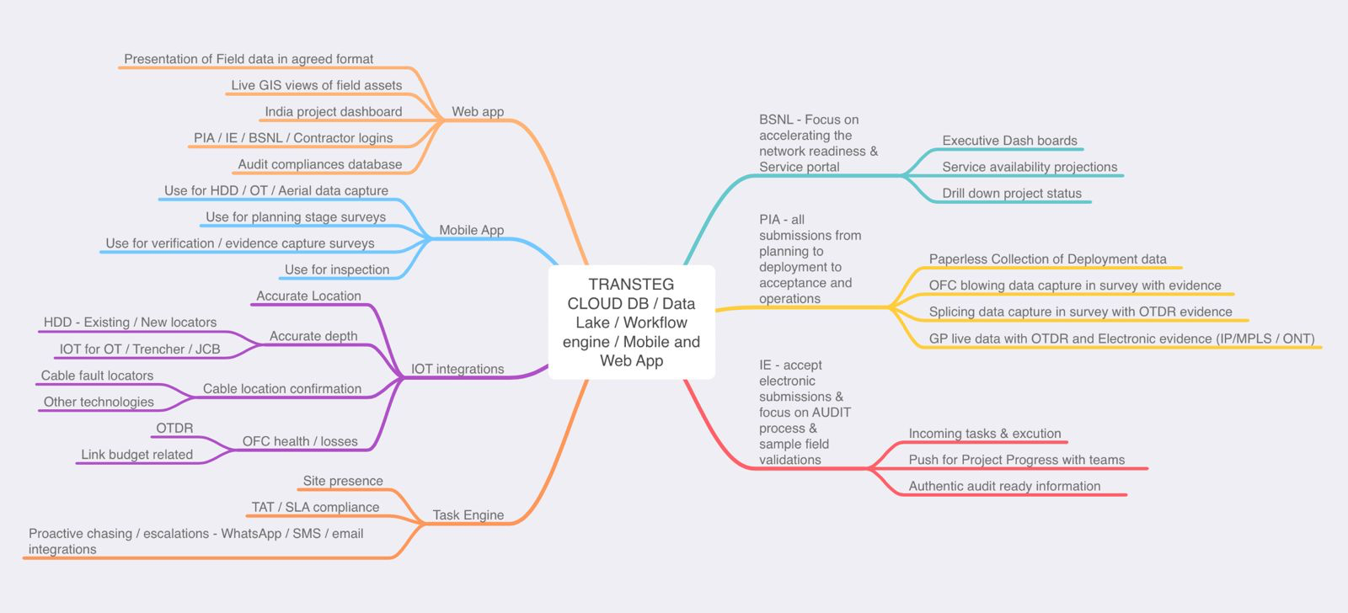



TRANSTEG Platform Status - Streamline the Tender processes to align teams towards the Goal
Complete/Field tested
In progress
On the Roadmap

Slide 16
THANK YOU FOR A PATIENT HEARING
We briefly covered PIA perspective
About
  T-TEG platform
  Paperless project communication
  Field measurements accumulation & usage
Bharatnet
  Lifecycle challenges
  Road to revenue
  Series of successes challenge
Approach / Solutions
Questions and Answers
  Intervention free data capture automation
  Align all to pre-defined Milestones
  Collaborative working across teams
  Vision for Bharatnet NOC

Slide 17

The Accountability Chain ®evolution – Fully customized NOC for end-to-end performance
& beyond based on Schedule of Powers
Modern Network Operations Center (NOC) for BharatNet Field Infrastructure Monitoring - Tracks optical fiber, GPON equipment, Power & all factors
Data Lake - Aggregates real-time network data using IoT sensors / telemetry. Stores data for predictive maintenance, root cause analysis, and task automation.
Performance Management for drill-down reports for stakeholders, tracking KPIs like uptime and delays.
24x7 Monitoring with automated and human agents for continuous oversight.
Trouble Ticket System for field tasks, ensuring accountability & transparency across hierarchy.
CEO
CXO
Regional Manager
I have checked as per process chain & recommend for approval chain
I trust you chain
Circle Manager
OFC manager
OFC field engineer
Contractor N
Resource 1 to n
Human intervention free accountability Chain running across multiple teams

Slide 18
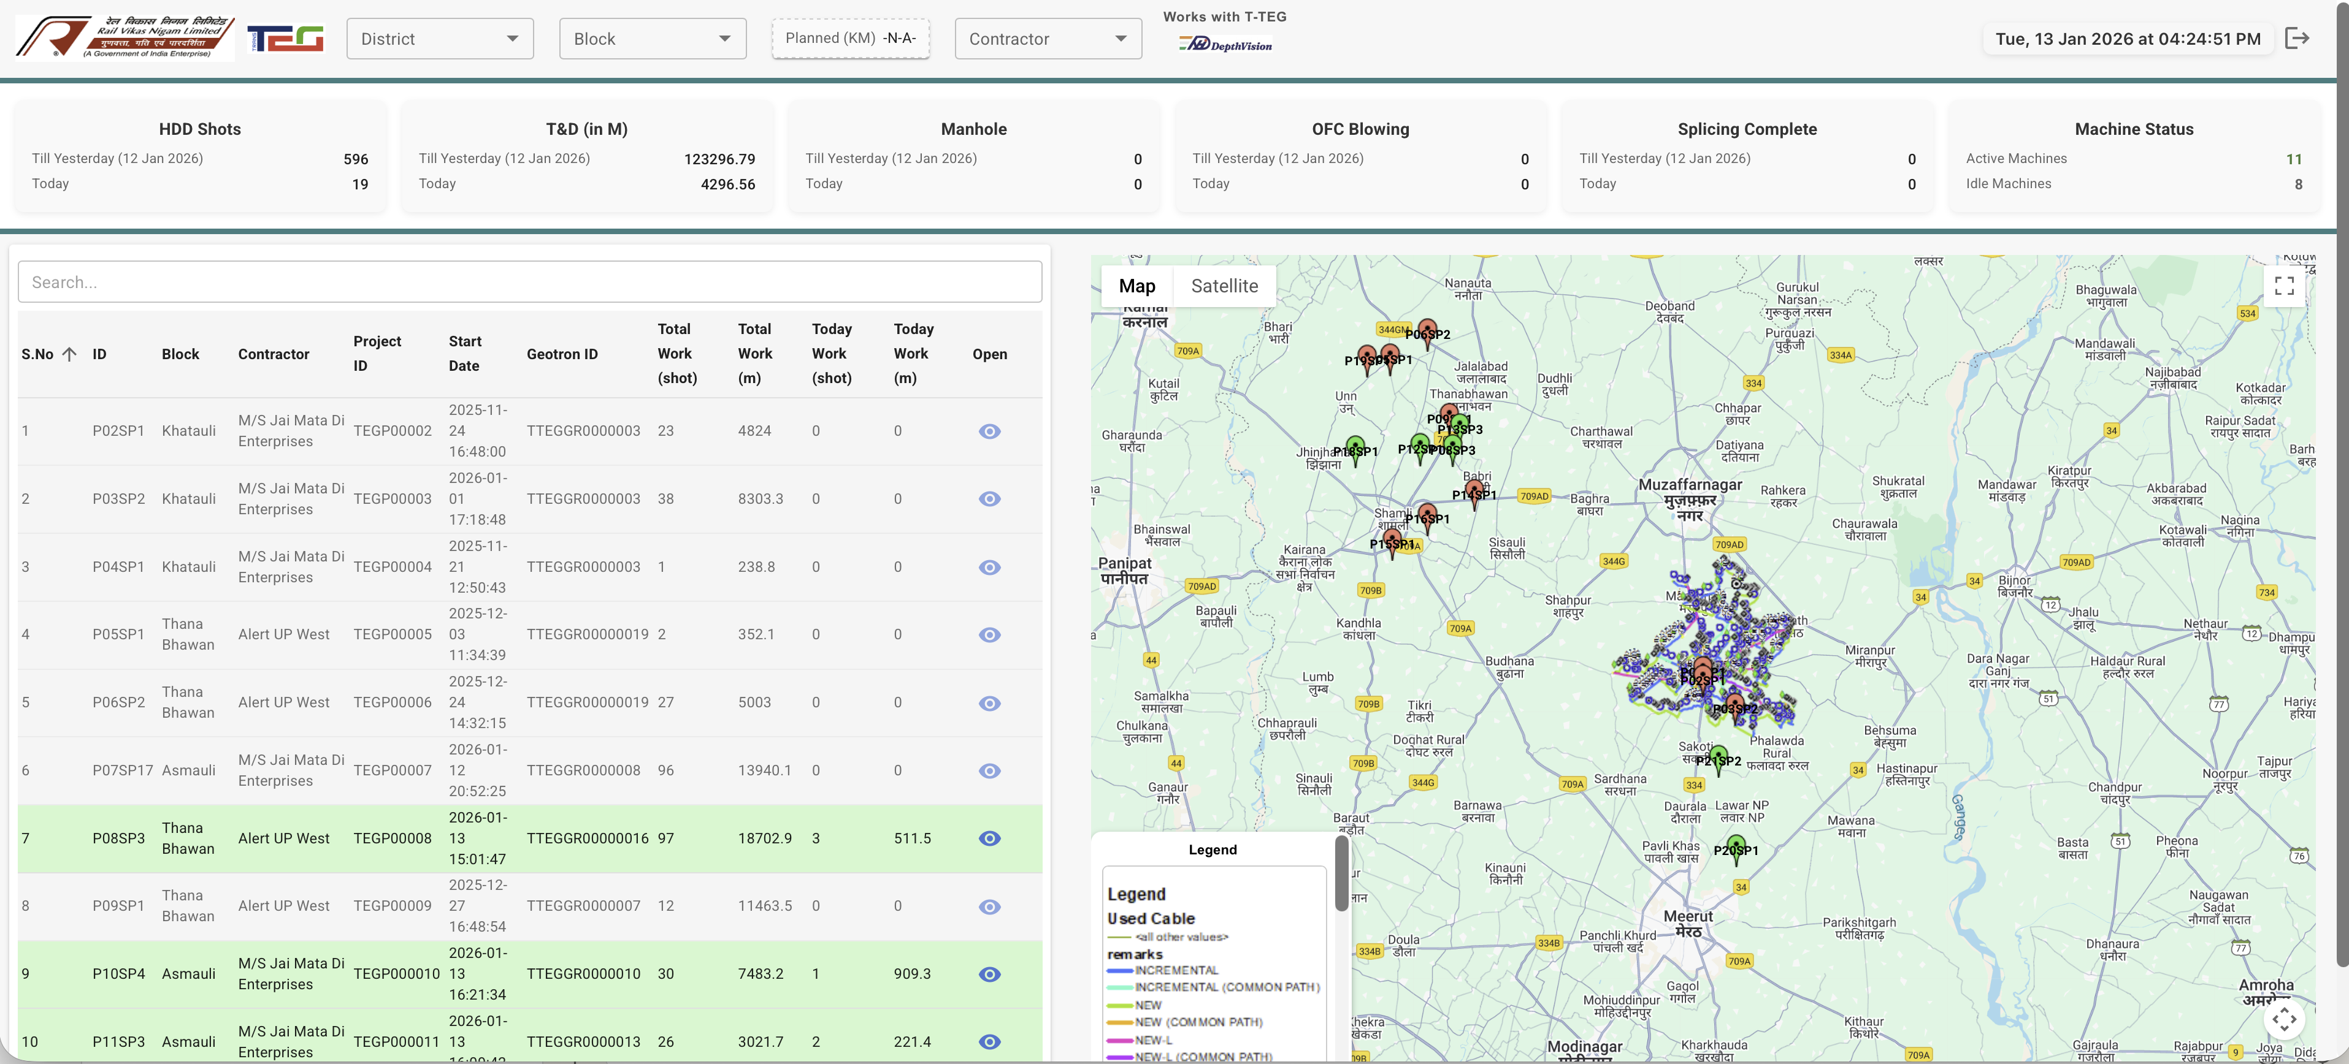
Network / ROW at a Glance – Live Dashboard Sample
Central office overview of large projects – showing machine locations, output from each machine, and output summarization for various levels. User can drill down two details at machine level as shown in next slide.

Slide 19
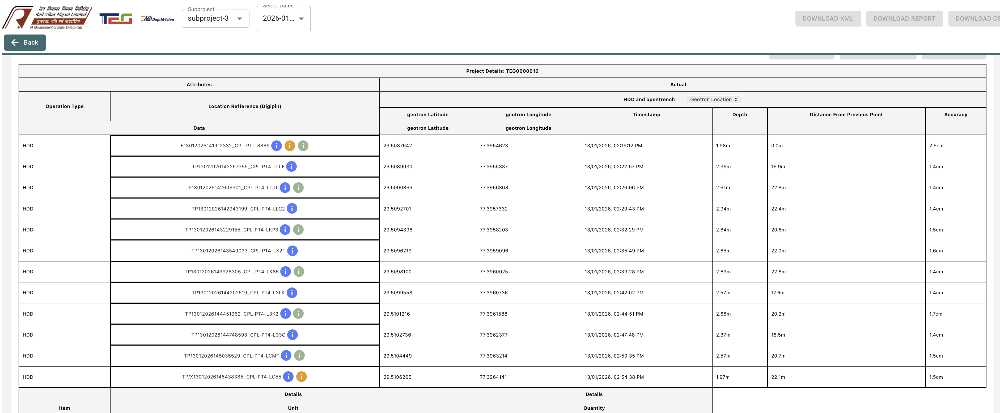
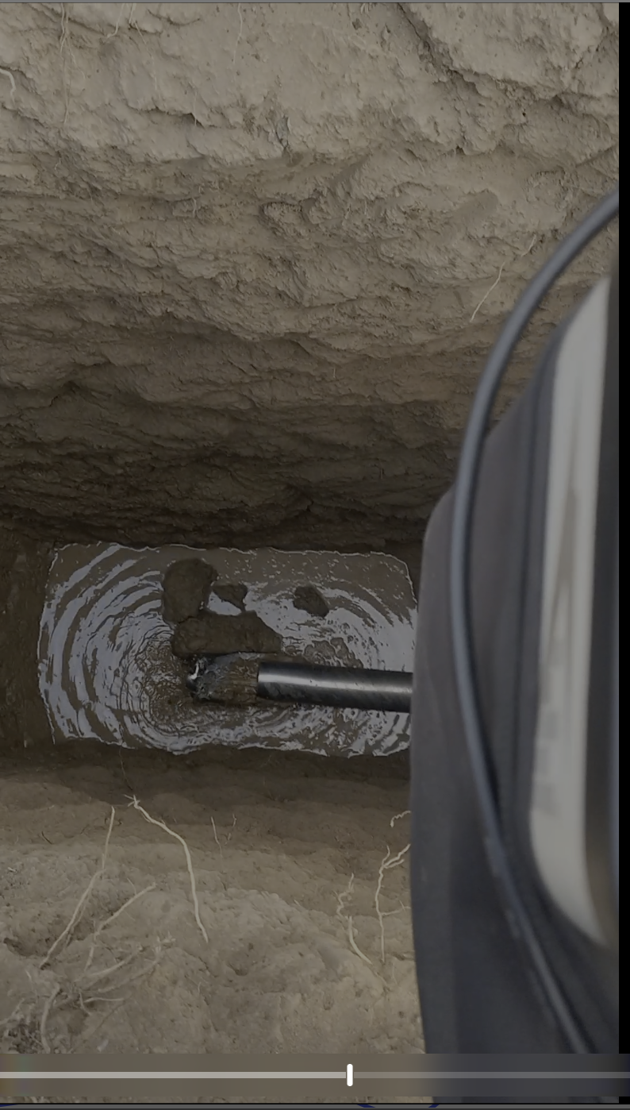
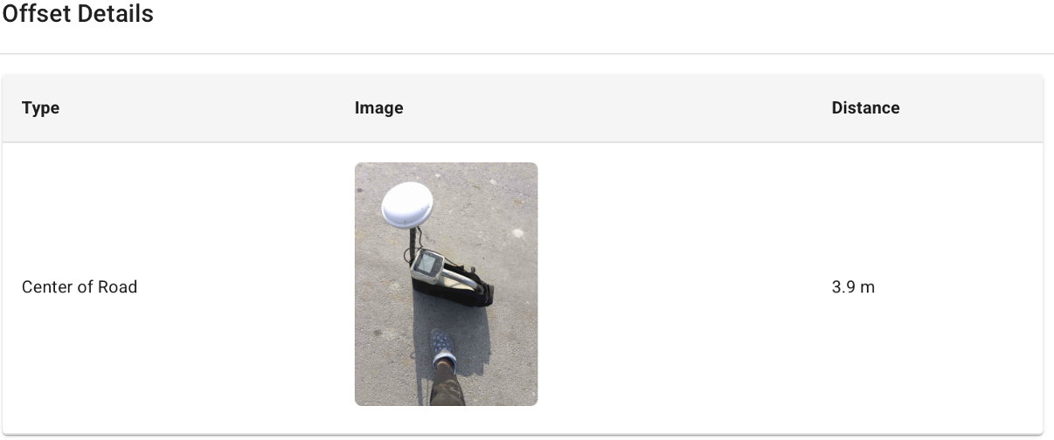
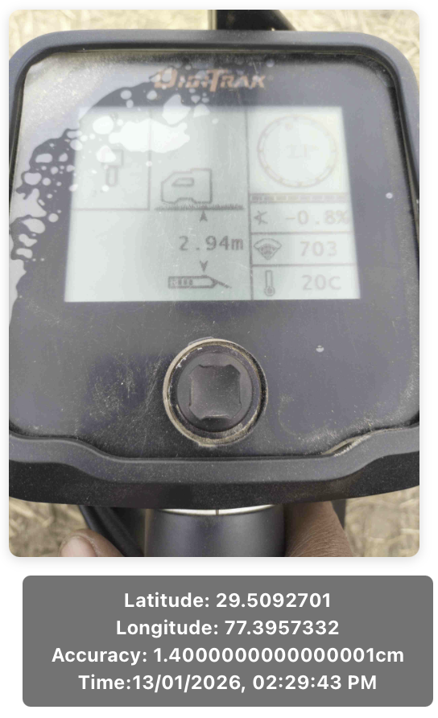
OFC Field Asset capture - Lifecycle
T-TEG Field asset deployment dashboard – captures live data from the field and presents to the executing or inspection agency for various project, acceptance and operations workflows
This data is the main input for electronic measurement book, where the techno commercial milestones are also tracked

Slide 20
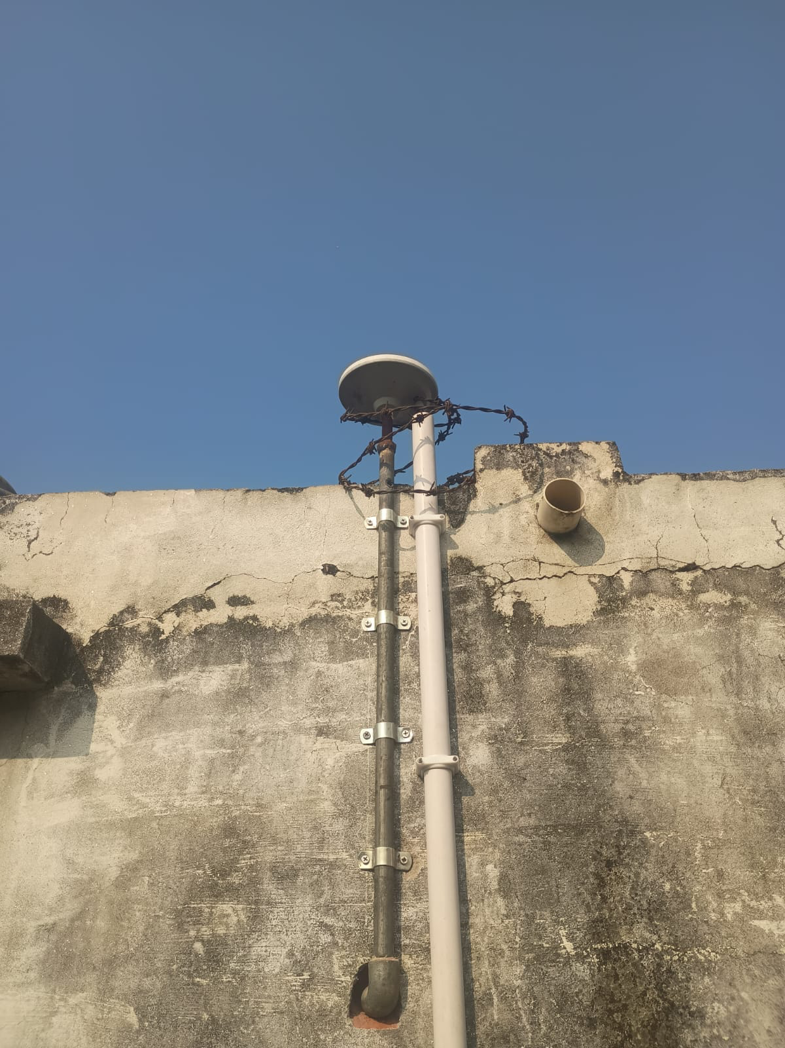
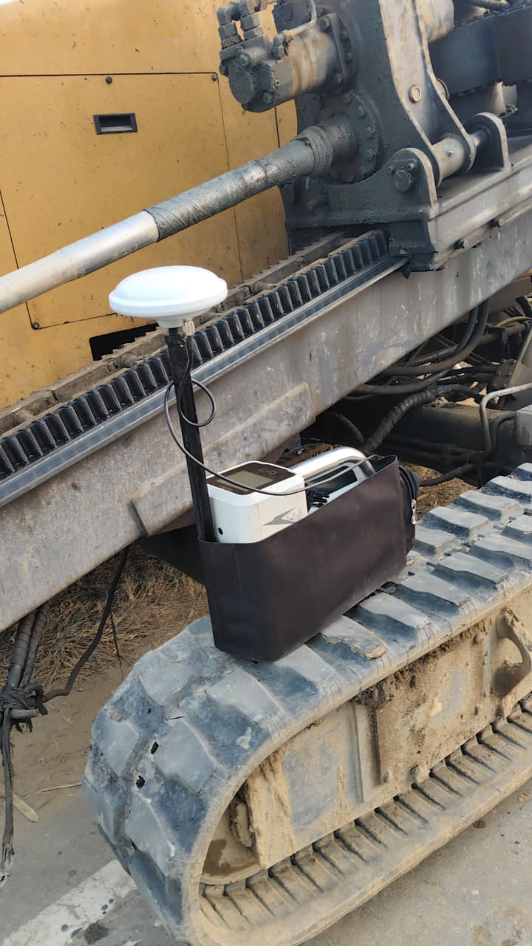
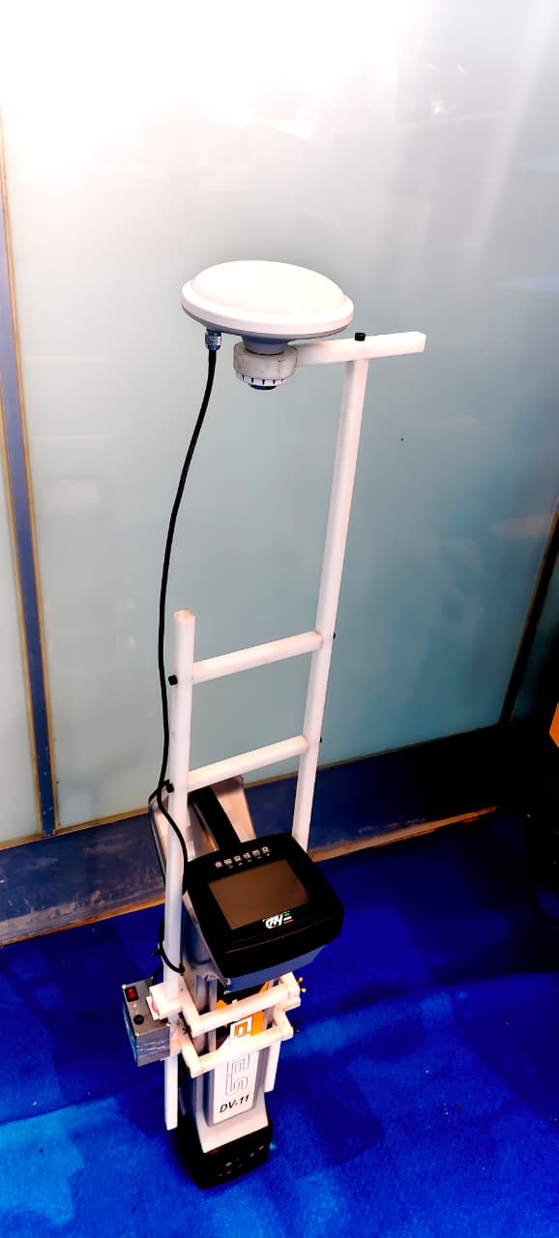
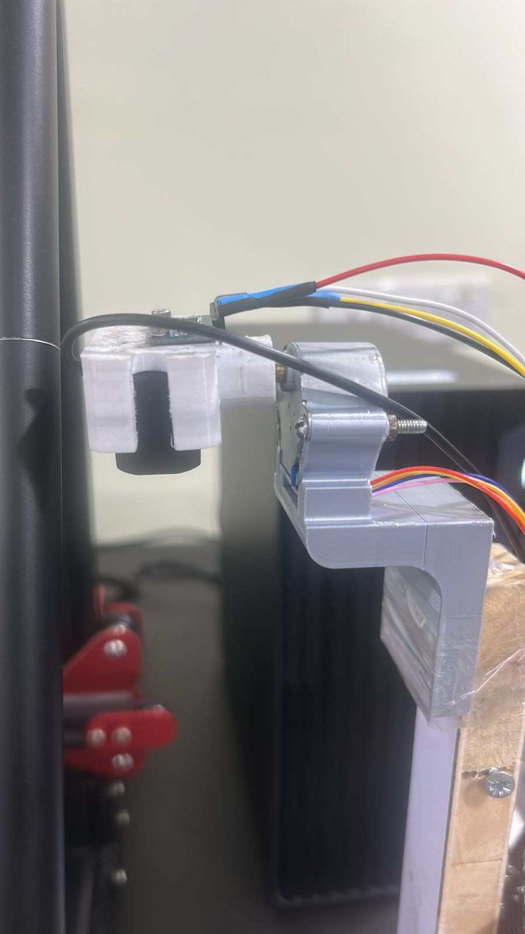
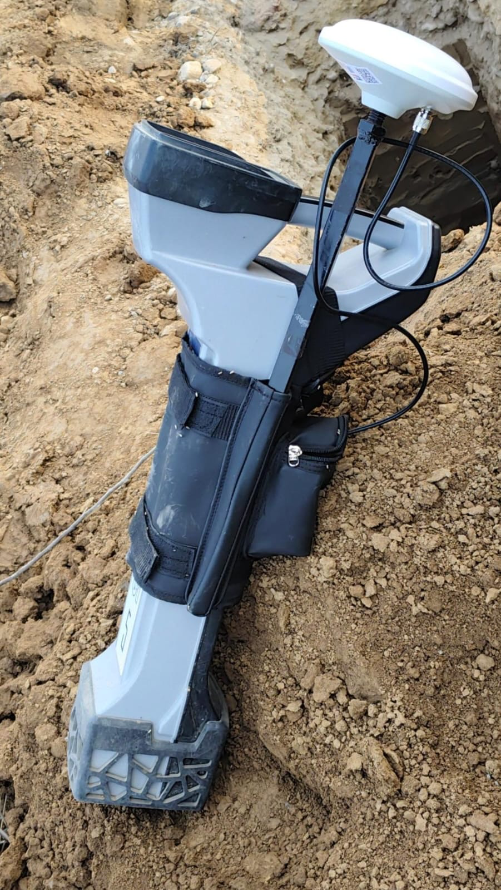
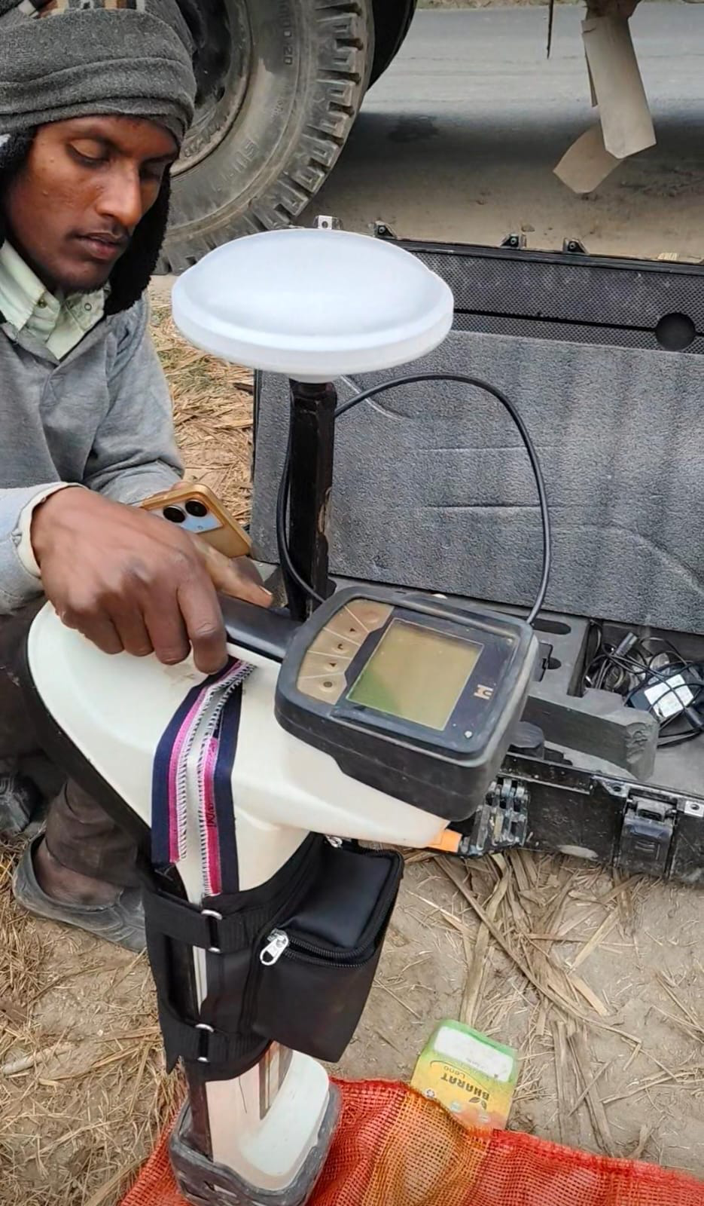
T-TEG IOT Devices – Open Trench / HDD asset capture
RTK Base with Antenna
Rover Antenna
HDD Locator
DCI with Geotron
HDD Locator
Depthvision
RTK Rover
GEOTRON - Own design / prototype / initial manufacture for Base and Rover - 25 working successfully in Ground.
Complete “AFFORDABLE accurate location as a service” set up for project and operations area with suitable automation for MTBF and MTTR
Depthking creates a 180° depth profile and matches it to any given template for intervention free depth measurement – reducing chance of Manipulation
Suitable for Automated Depth Measurements with “Single Press” Depth profile & Accurate Location Capture
HDD Locator
Underground Magnetics with Geotron

